Slide 1

CB11 Public Sites Project
George M. Janes
& Associates
250 E. 87th Street
New York, NY 10128
Tel: 646.652.6498
george@georgejanes.com
5/9/2018

Slide 2
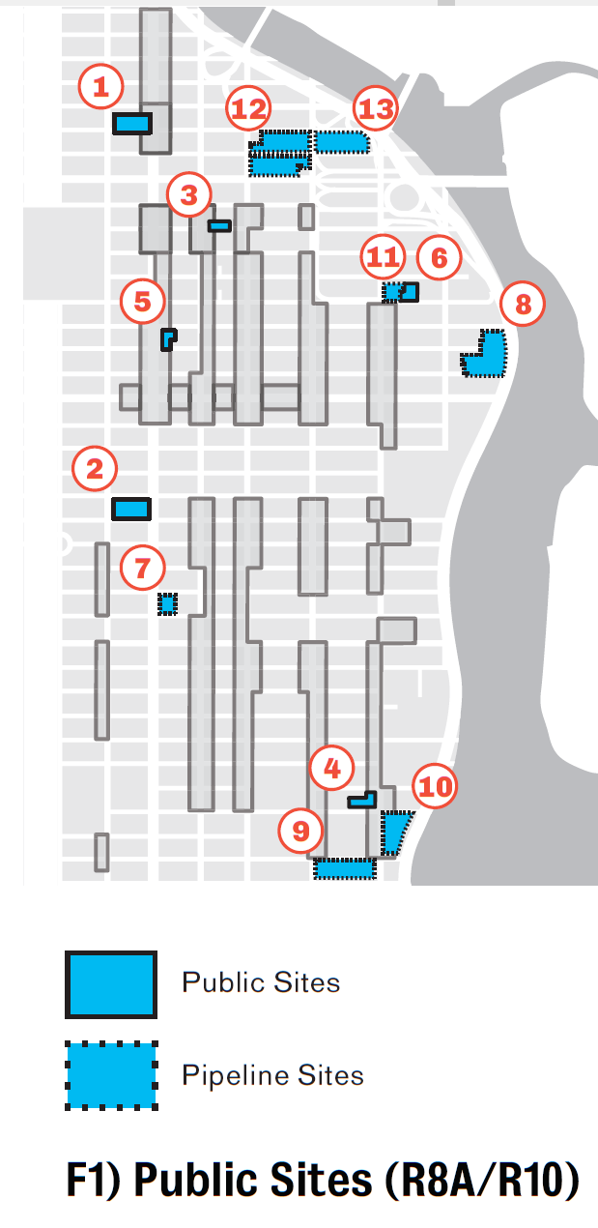
In 2015, the East Harlem Neighborhood Plan identified several potential public sites for development
The plan recommended that these sites be:
100% affordable
Rezoned either R10 or R8A to maximize the number of units

Slide 3
As a part of the 2017 East Harlem Rezoning POA, the City agreed to redevelop four of these sites
1) Urban Assembly school
3) Sanitation Parking Lot
5) NYPD parking lot
6) Multi-Service Center

Slide 4
HPD has stated their intention to RFP two of these sites in early to mid 2019
1) Urban Assembly school
3) Sanitation Parking Lot
5) NYPD parking lot @ Park Ave. between 118th and 119th Streets
6) The Multi-Service Center @ 120th near First Ave.

Slide 5
The CB11 Public Lands Project will proactively define what the CB wants on these projects
There are three broad areas of project definition the CB should consider:

Slide 6
The CB11 Public Lands Project will proactively define what the CB wants on these projects
There are three broad areas of project definition the CB should consider:
Building Massing
How big are the buildings, what are their forms and shapes, how do they interact with the street, location on the lot, open space

Slide 7
The CB11 Public Lands Project will proactively define what the CB wants on these projects
There are three broad areas of project definition the CB should consider:
Building Massing
How big are the buildings, what are their forms and shapes, how do they interact with the street, location on the lot, open space
Building Program
What happens in the building? What kind of uses (e.g. commercial, community facility, residential)? What is the unit mix (e.g. number of BRs)?

Slide 8
The CB11 Public Lands Project will proactively define what the CB wants on these projects
There are three broad areas of project definition the CB should consider:
Building Massing
How big are the buildings, what are their forms and shapes, how do they interact with the street, location on the lot, open space
Building Program
What happens in the building? What kind of uses (e.g. commercial, community facility, residential)? What is the unit mix (e.g. number of BRs)
Affordability
Amount of affordability, depth of affordability, term of affordability

Slide 9
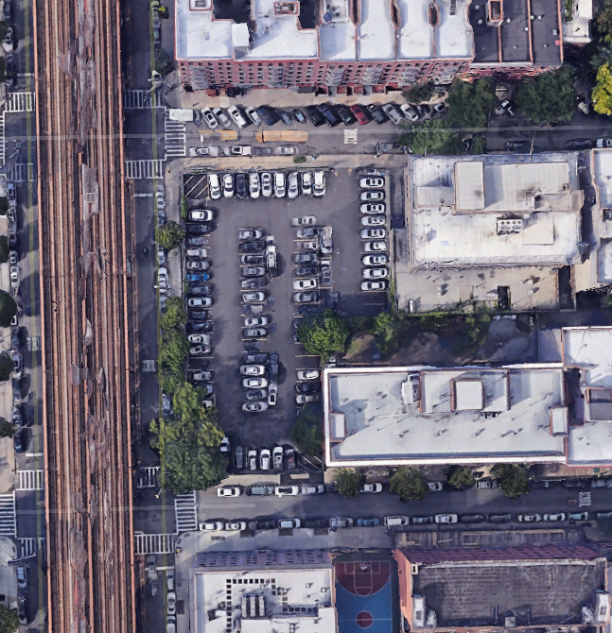
Today’s focus will be the NYPD parking lot
119th Street
Park Ave
118th Street

Slide 10
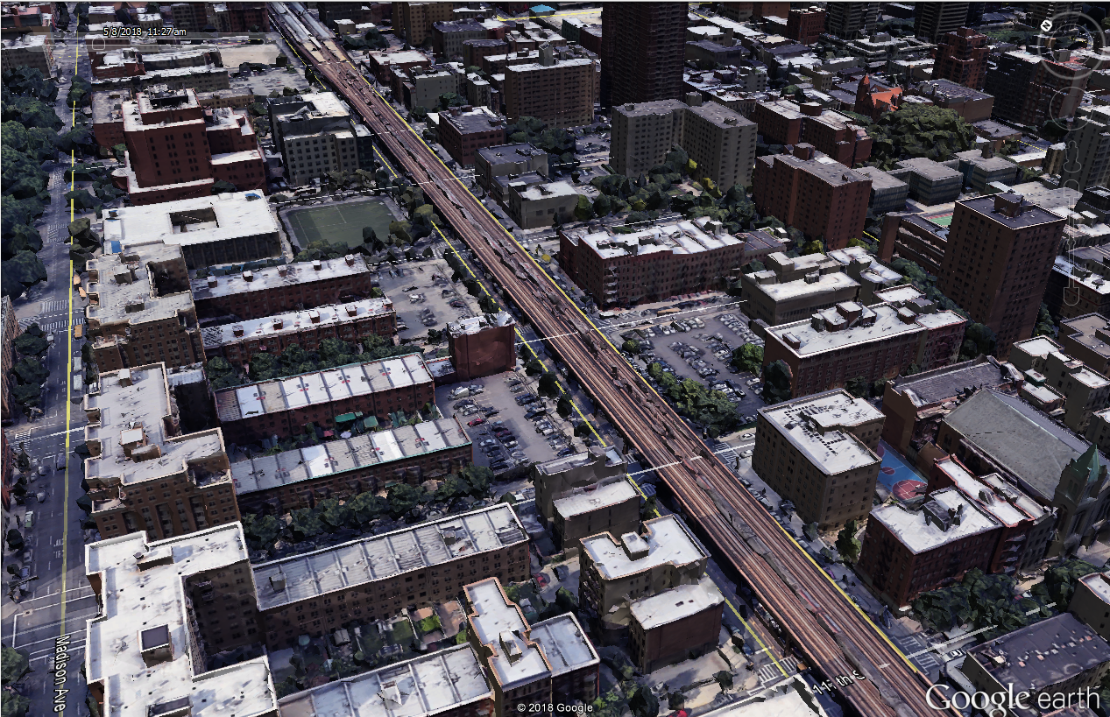
Park Ave was rezoned in 2017 to allow for much larger buildings
NYPD lot
119th Street
Park Ave
118th Street

Slide 11
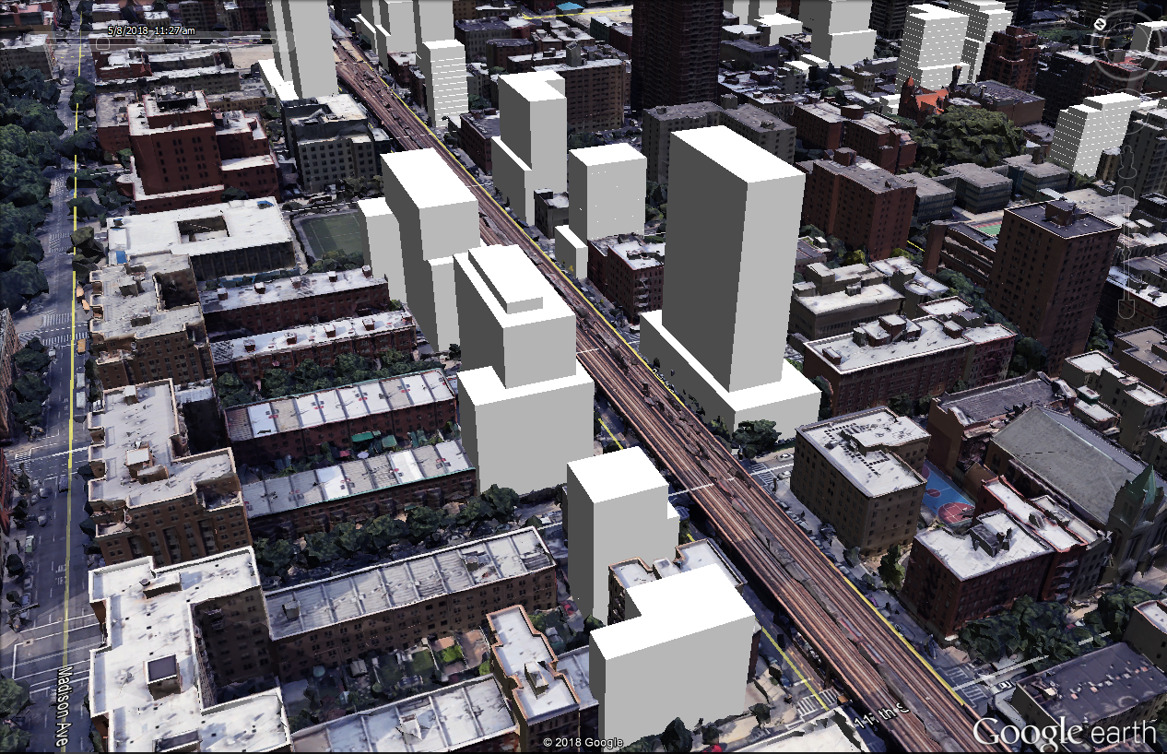
Park Ave was rezoned in 2017 to allow for much larger buildings
NYPD lot
119th Street
Park Ave
118th Street

Slide 12
Most of the NYPD lot was rezoned to R10 with a commercial overlay
Allows towers on a base
Base height between 40 and 80 feet
Tower height limited to 295 feet
Up to 12 FAR
Up to 2 of that 12 FAR may be Commercial
No parking required for affordable housing or commercial uses
Mandatory Inclusionary Housing Options 1 and 3
Part of site in R7B midblock site

Slide 13

Scenario 1: Based on rezoning assumptions
231,266 SF of Residential / 257 units
27,258 SF of commercial
11,011 SF of above grade parking (~40 spaces)
Building height 280 feet
Base height 80 feet

Slide 14

Scenario 1: Ground floor
Retail to activate street frontage
Lobby along 118th St
NYPD parking with a mezzanine level
About 130 NYPD spaces including cellar
Parking
12,500 SF of retail
Lobby

Slide 15

Scenario 1: Second floor
Non-residential use on second floor to raise residential above tracks
Parking
14,758 SF of commercial

Slide 16
Scenario 1: floors 1 through 27
231,266 SF of Residential / 257 units
27,258 SF of commercial
11,011 SF of above grade parking (~40 spaces)
Building height 280 feet
Base height 80 feet

Slide 17
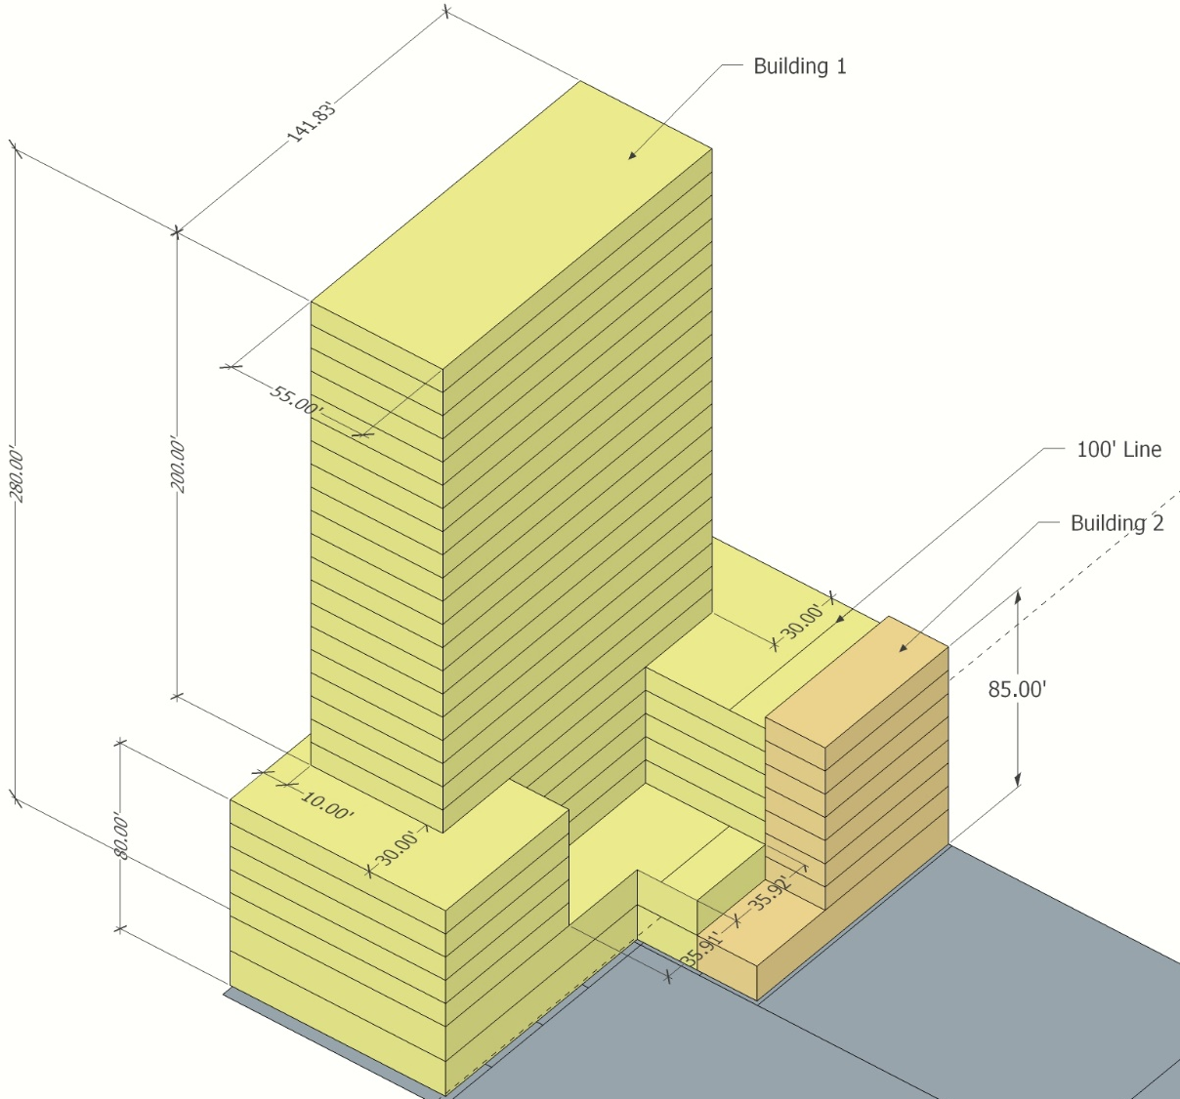
Scenario 1: Back of building and dimensions

Slide 18
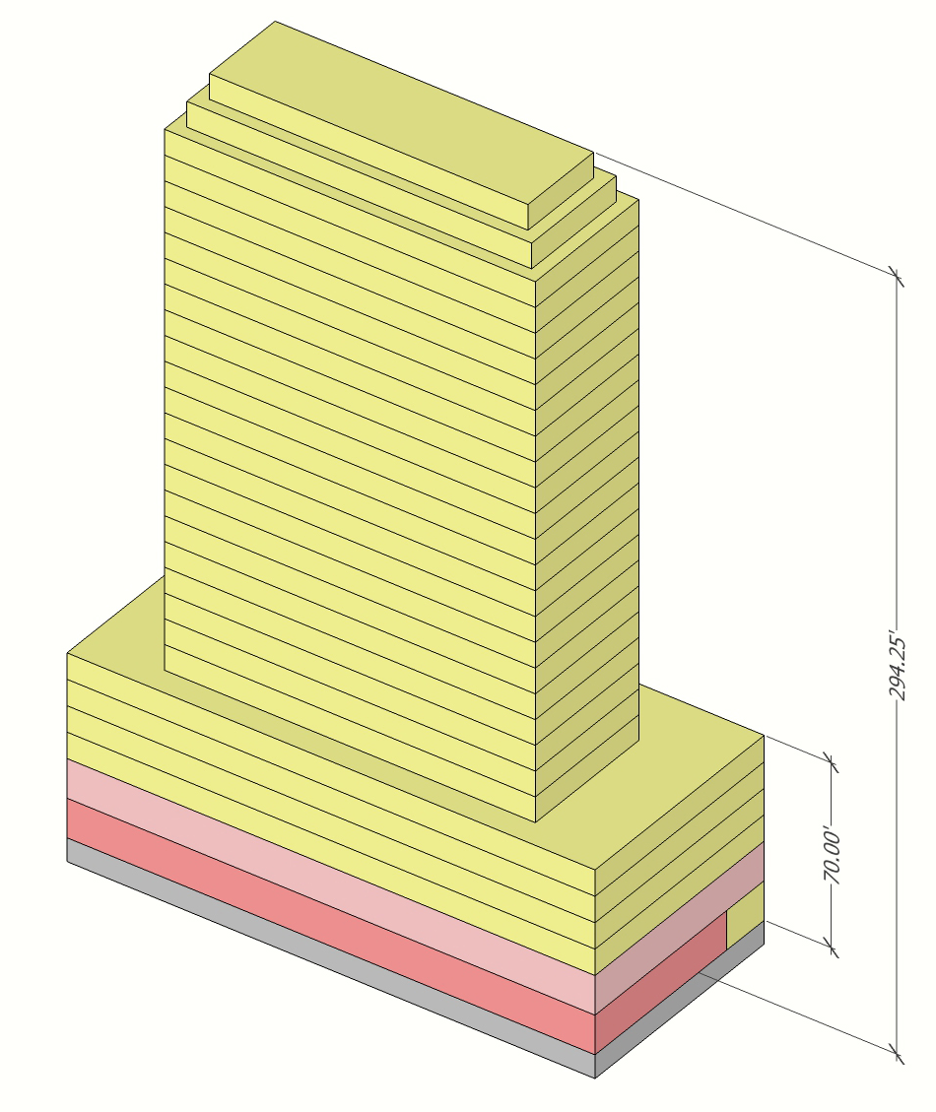
Scenario 2: More reasonable massing
Max of building height (+14.25 feet)
Lowers base height (-10 feet)
Otherwise, program the same

Slide 19
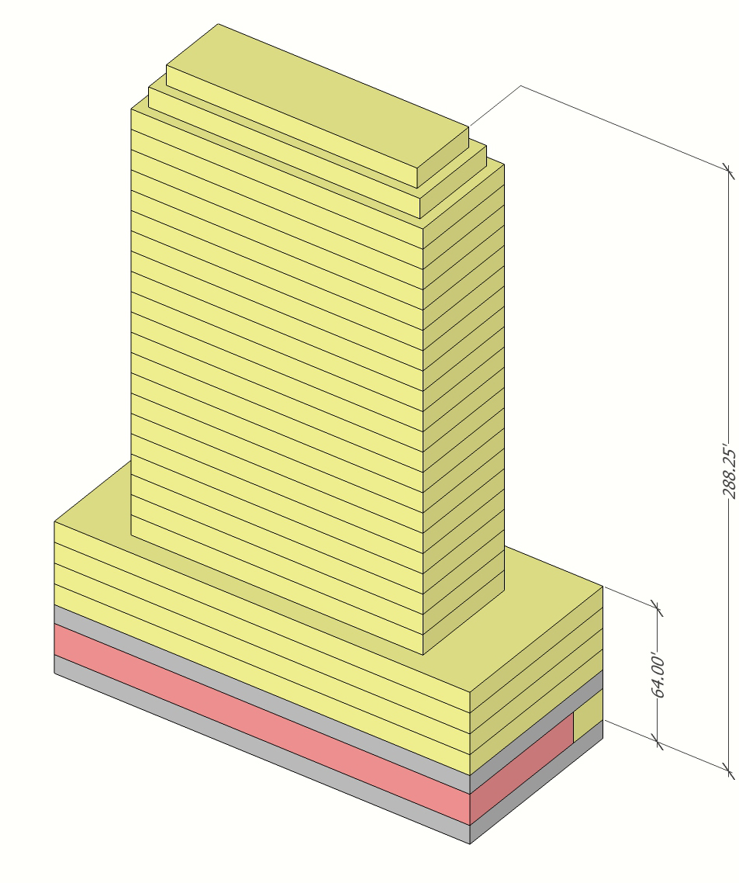
Scenario 3: More reasonable massing with expanded parking
Commercial office replaced with expanded NYPD parking
No loss of units
Group parking facilities limited to 150 spaces, or 225 with DOB certification
Produces ~225 spaces
Slightly shorter base and building height

Slide 20
Affordability
EHNP called for 100% affordable units on these sites
Since they are publicly owned, the City can dictate the terms and levels of affordability
MIH is triggered requiring 20 or 25% of units to be permanently affordable
The affordability can follow an HPD term sheet or be modeled after other buildings
The following shows the NYPD site modeled under different programs

Slide 21
Lexington Gardens model

Slide 22
Sendero Verde model

Slide 23
Acacia Gardens model

Slide 24
Mixed Income Model

Slide 25
Breadth and depth of affordability is limited to how much the City is willing to subsidize
Acceptable outcomes should be discussed internally and then discussed with HPD
CB should consider that different sites may have different affordability profiles and requirements
Tower construction is expensive and may not allow deeper levels of affordability
The Sanitation site and the Multi-Service Center are likely to be mid-rise construction, like Acacia Gardens
The Urban Assembly site will likely be a mix of tower and mid-rise, like Sendero Verde

Slide 26
Questions & Feedback on NYPD?
Massing
Program
Affordability

Slide 27
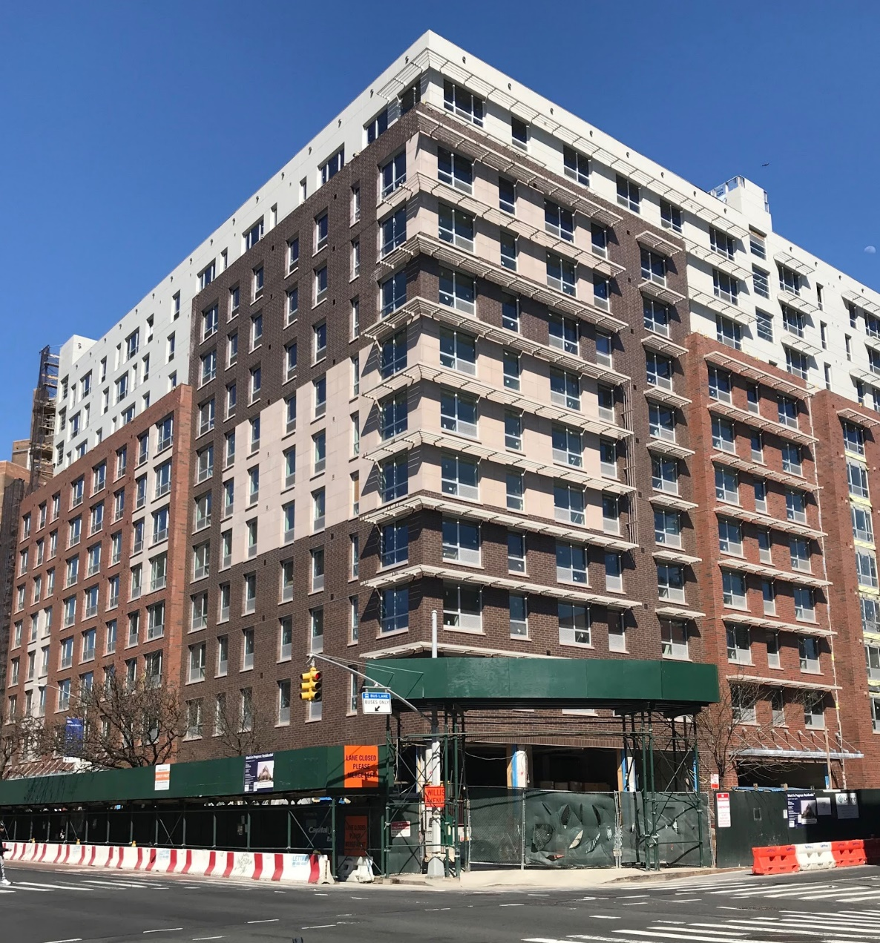
Questions for the Multi-Service Center for June
The Multi-Service Center is much more complex: It will need rezoning. Do we want another building like Acacia Gardens?

Slide 28
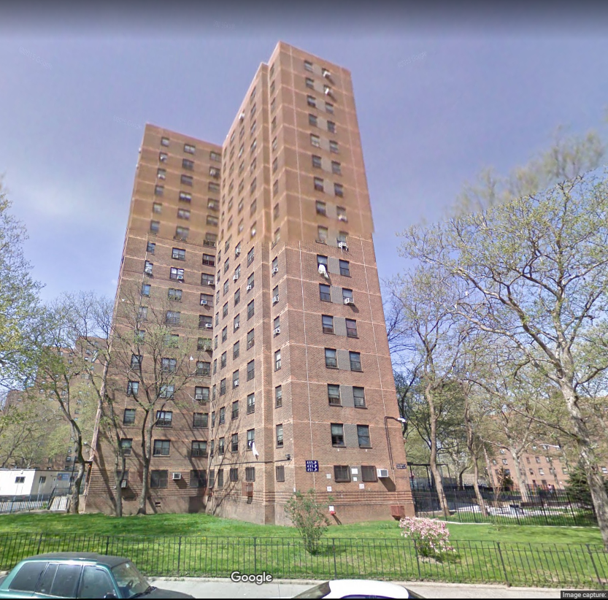
Questions for the Multi-Service Center (MSC) for June
Or do we prefer something taller and less bulky, like the neighboring towers?

Slide 29
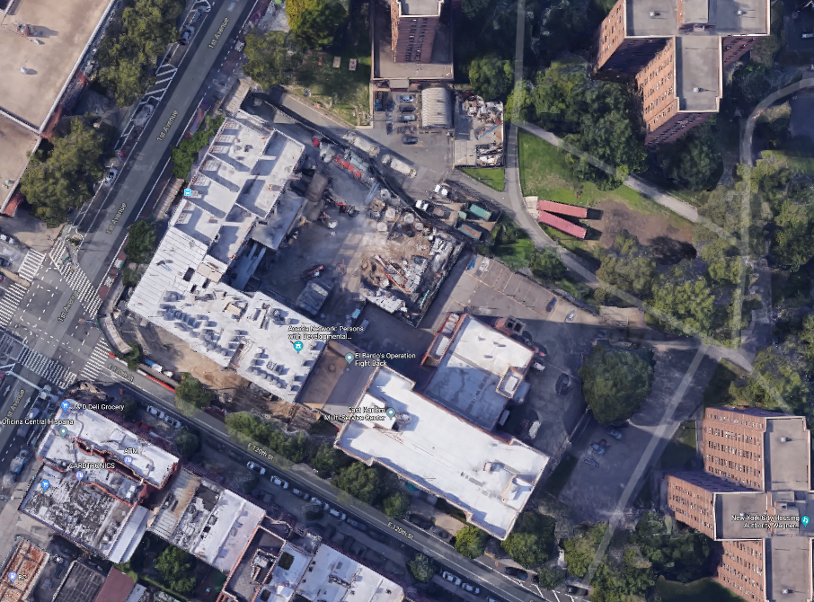
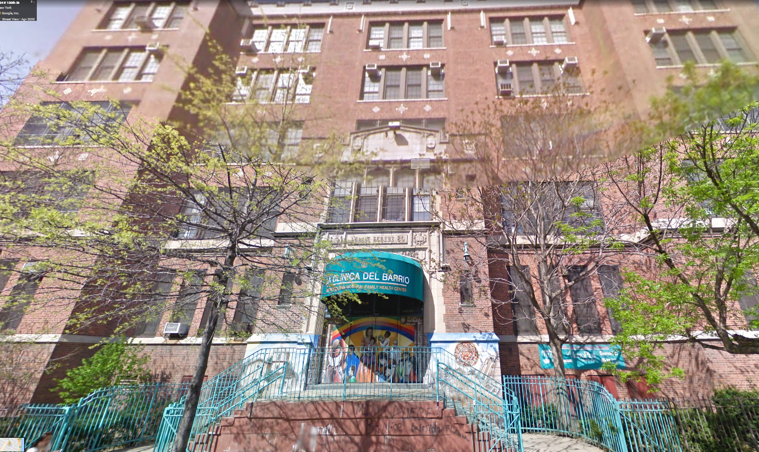
Questions for the MSC for June
Do we keep the existing MSC? The facility is old: Do we require a new one? Gut rehab? Is there another location?
If it is kept, the resulting building will likely be smaller and have less housing

Slide 30
Other thoughts & direction?

Slide 31
CB11 Public Sites Project
George M. Janes
& Associates
250 E. 87th Street
New York, NY 10128
Tel: 646.652.6498
george@georgejanes.com
5/9/2018

